Slide 1
Input Image 224×224×3
DenseNet121
EfficientNetV2-B1
ResNet152V2
Projection Conv2D
(128 channels, act=GeLU)
Projection Conv2D
(128 channels, act=GeLU)
Projection Conv2D
(128 channels, act=GeLU)
Batch Normalization
Batch Normalization
Batch Normalization
4× Upscaling
4× Upscaling
4× Upscaling
(56 ×56 ×128)
(56 ×56 ×128)
(56 ×56 ×128)
Concatenation
(384 Channels, 56×56)
Fusion Convolutions (256 Channels, 3×3 Kernel, GeLU, BatchNorm, L1L2 Regularization)
Global Average Pooling
Vector (256)
Dense Head
Dense (256,
GeLU)
BatchNorm
Dropout
(0.35)
Dense (128,
GeLU)
BatchNorm
Dropout
(0.3)
Dense (1, Sigmoid)

Slide 2
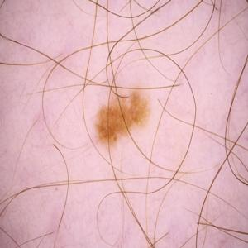
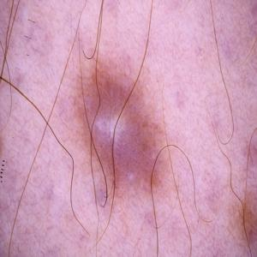
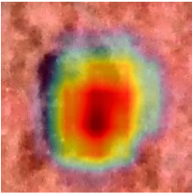
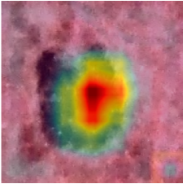
Merged Dataset
Preprocess Image
2 Class-
Benign
Malignant
Total 29,970 Images
Hair Removal:
Dull Razor: Detect & inpaint hairs
Illumination Correction:
Correct uneven lighting (LAB L-channel)
Contrast Enhancement:
CLAHE on L-channel to improve contrast
Resize & Pixel Normalization:
224×224×3 size and Min-Max for [0-1] pixel range.
SkinFusedNet
Training Augmentaion
Dataset Split
DenseNet121
Rotation, Zoom, Width Shift, Height Shift, Horizontal Flip, Vertical Flip, Brightness Adjustment, Channel Shift, fill_mode=nearest
Train 80%
EfficientNetV2B1
Validation 10%
Image from 5 Publicly
Available Dataset
ResNet152V2
Test 10%
Trained
Model
XAI
Accuracy
Precision
Recall
F1-Score
AUC
95% CI
GradCam++
ScoreCam

